Slide 1
Advanced SQL and Connector /J
Amos Azaria

Slide 2

Variables
User-defined variables (@):
SET @passGrade = 60
SELECT @avgGrade := AVG(grade) FROM grades
Local variables in stored procedures (will learn later)
DECLARE passGrade INT
To see a variable's value you can SELECT it:
SELECT @avgGrade
It behaves slightly differently when using ‘=‘
Notes:
When using ‘:=‘ the SELECT returns the updated value.

Slide 3
TEMPORARY TABLE
Variables cannot hold tables.
If you would like to use a table during execution, you can use the TEMPORARY keyword:
CREATE TEMPORARY TABLE tempTable (id INT, name VARCHAR(1000));
INSERT INTO tempTable (SELECT id, lastName FROM students);
(5 rows effected)
You can also combine create with select:
CREATE TEMPORARY TABLE tempTable2 AS (SELECT * FROM students);
Notes:
A TEMPORARY table is visible only to the current connection, and is dropped automatically when the connection is closed. This means that two different connections can use the same temporary table name without conflicting with each other or with an existing non-TEMPORARY table of the same name. (The existing table is hidden until the temporary table is dropped.)

Slide 4
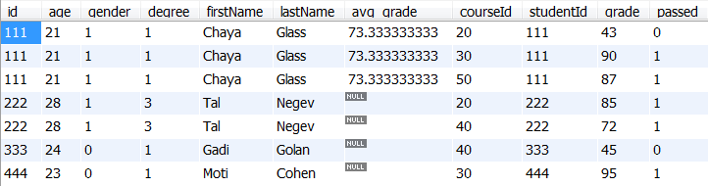
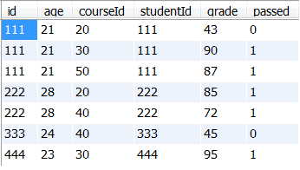
Aliases
SELECT * FROM students AS s INNER JOIN grades AS g ON s.id=g.studentId;
SELECT * FROM students s INNER JOIN grades g ON s.id=g.studentId;
SELECT * FROM (SELECT id, age FROM students) AS s INNER JOIN grades AS g ON s.id=g.studentId;

Slide 5


Aliases (cont.)
SELECT age+10 FROM students;
SELECT age+10 AS future_age FROM students;

Slide 6

Aliases in Nested Queries
We saw nested queries in the WHERE clause, but it can be used in the FROM clause.
SELECT MAX(av)
FROM (SELECT studentId, AVG(grade) AS av FROM grades
GROUP BY studentId) ;
AS t;

Slide 7

Obtain all students with the highest average
If we want to select the studentId in the outer query-
SELECT t.studentId, t.av
FROM (SELECT studentId, AVG(grade) AS av
FROM grades
GROUP BY studentId) AS t
WHERE t.av = (SELECT MAX(dd.av)
FROM (SELECT studentId, AVG(grade) AS av FROM grades
GROUP BY studentId) AS dd);

Slide 8

Aliases in Nested Queries cont.
Nested queries can be also in the SELECT clause-
SELECT s.id,
s.firstName,
s.lastName,
(SELECT COUNT(grade) FROM grades g WHERE s.id = g.studentId) AS num_of_courses
FROM students s

Slide 9
Transactions
Suppose we want to transfer money from one bank account to another:
SET @transferAmount = 1000;
SELECT @firstBalance := amount FROM bankBalances WHERE userId = 777;
UPDATE bankBalances SET amount := @firstBalance - @transferAmount WHERE userId = 777;
SELECT @secondBalance := amount FROM bankBalances WHERE userId = 888;
UPDATE bankBalances SET amount := @secondBalance + @transferAmount WHERE userId = 888;
What might be the problem with this execution?
What if we run another instance of this query at this point?
What if the program crashes here?

Slide 10
Transactions (cont.)
Transactions are guaranteed to be executed completely or nothing at all (Atomicity in ACID). In this example we also rely on the Isolation attribute (and Durability).
When using a single query, it is treated as a transaction.
We can combine several queries into a single transaction by using START TRANSACTION and ending with COMMIT.

Slide 11
Transactions (cont.)
SET @transferAmount = 1000;
START TRANSACTION;
SELECT @firstBalance := amount FROM bankBalances WHERE userId = 777;
UPDATE bankBalances SET amount := @firstBalance - @transferAmount WHERE userId = 777;
SELECT @secondBalance := amount FROM bankBalances WHERE userId = 888;
UPDATE bankBalances SET amount := @secondBalance + @transferAmount WHERE userId = 888;
COMMIT;

Slide 12
Transactions (ROLLBACK)
If you have any error during the transaction, you can call ROLLBACK to undo the current transaction (until previous COMMIT).

Slide 13
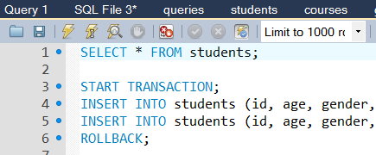
Transactions in WorkBench
There are several transaction related buttons on the workbench toolbar:
Continue even if an error occurs.
Autocommit every query.
I found it very difficult to write a transaction in workbench with a ROLLBACK in case of error (and COMMIT otherwise). Though, this is the regular behavior if using the MySql command-line client.
Show ROLLBACK / COMMIT example in WorkBench

Slide 14
Stored Procedures
Procedures that are stored inside the database:
Can be accessed from different programming languages.
Can save communication time
Can be modified 'on the fly' (changes can be made without restarting the server)

Slide 15
Stored Procedure - Example
DELIMITER $$
CREATE PROCEDURE student_avg
(IN stId INT)
BEGIN
SELECT AVG(grade) FROM grades WHERE studentId = stId;
END $$
DELIMITER ;
We need to change the delimiter, which separates commands, since we use ';' inside the stored procedure. When we finish, we change it back to ';'

Slide 16

Stored Procedure (cont.)
CALL student_avg(111);
DROP PROCEDURE student_avg
MySQL doesn't (really) support ALTER PROCEDURE, so in order to change a procedure you need to first drop it and then create it again.

Slide 17

Another Example
DELIMITER $$
CREATE PROCEDURE `student_avg_2`(IN stId INT, OUT avg_g REAL, OUT max_g INT)
BEGIN
SELECT AVG(grade) INTO avg_g FROM grades WHERE studentId = stId;
SELECT MAX(grade) INTO max_g FROM grades WHERE StudentId = stId;
END$$
DELIMITER ;
CALL student_avg_2(222, @avg_grade, @max_grade);
SELECT @avg_grade, @max_grade;

Slide 18
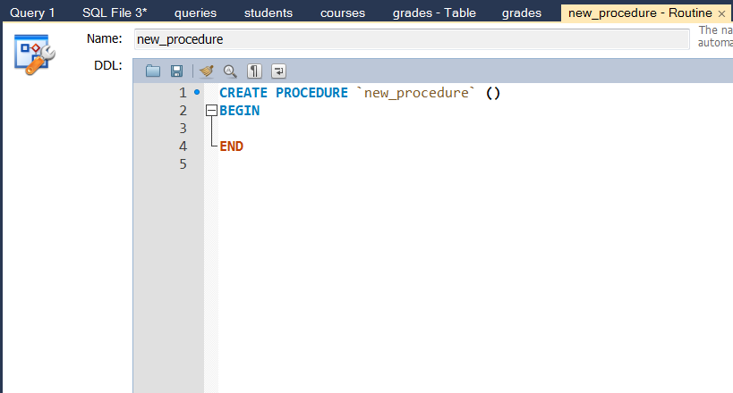
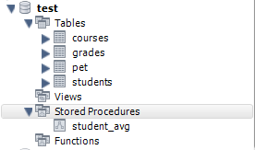
Stored Procedure Workbench
In Workbench you can easily create and alter stored procedures using the GUI.
Simply right click on the "Stored Procedures" and select "Create" to create a stored procedure.
Right click on a stored procedure and select "alter stored procedure"

Slide 19
Transactions and Errors in Stored Procedures
CREATE PROCEDURE `transfer_balance`(
IN sender INT,
IN receiver INT,
IN trAmount REAL)
BEGIN
DECLARE EXIT HANDLER FOR SQLEXCEPTION, SQLWARNING
BEGIN
ROLLBACK;
SELECT 'Error occurred' as Message;
END;
START TRANSACTION;
SELECT @sBl = amount FROM bankBalances WHERE userId = sender;
UPDATE bankBalances SET amount = @sBl - trAmount WHERE userId = sender;
SELECT @rBl = amount FROM bankBalances WHERE userId = receiver;
UPDATE bankBalances SET amount = @rBl + trAmount WHERE userId = receiver;
COMMIT;
END;

Slide 20
CREATE PROCEDURE [dbo].[PgRequestToPlaySP]
-- Add the parameters for the stored procedure here
@workerId nchar(20),
@assignmentId nchar(40),
@agentPlay int,
@incriminateMode bit,
@isIn bit out
AS
BEGIN
SET NOCOUNT ON;
--if has entry, update last seen
declare @hasEntry as int;
declare @expNum as int;
set @expNum = 41;
select @isIn = 1 from PgGames where workerId=@workerId and assignmentId=@assignmentId and status = 1;
if (@isIn = 1)
begin
return @@Error;
end
set @isIn = 0;
select @hasEntry = count(*) from PgWaitingList where workerId=@workerId and assignmentId=@assignmentId and expNum=@expNum;
if (@hasEntry > 0)
begin
update PgWaitingList set lastSeen = CURRENT_TIMESTAMP where workerId=@workerId and assignmentId=@assignmentId and expNum=@expNum;
end
else
begin
insert into PgWaitingList (expNum,workerId,assignmentId,insertTime,lastSeen) values (@expNum,@workerId,@assignmentId,CURRENT_TIMESTAMP,CURRENT_TIMESTAMP);
end
--select top 4 desc and create new games
declare @numOfWaiting as int;
delete from PgWaitingList where lastSeen < DateADD(mi, -1, Current_TimeStamp); --remove old players
select @numOfWaiting = count(*) from PgWaitingList where expNum=@expNum;
if (@numOfWaiting >=4-@agentPlay)
begin
--build new games
declare @maxGameId as int;
select @maxGameId= max(gameId) from PgGames;
if (@maxGameId is null)
begin
set @maxGameId = 1;
end
if (@maxGameId < @expNum * 1000)
begin
set @maxGameId = @expNum * 1000;
end
--do I need to lock the following two queries?
insert into PgGames (expNum, workerId, assignmentId, gameId, status, playerId, isPirate, insertTime)
select top(4-@agentPlay) @expNum, workerId, assignmentId, @maxGameId+1, 1, -1, 0, CURRENT_TIMESTAMP from PgWaitingList where expNum=@expNum order by insertTime;
delete from PgWaitingList where assignmentId in (select assignmentId from PgGames where status=1); --remove from waiting
update top (1) PgGames set isPirate=1 where playerId=-1 and assignmentId = (select top 1 assignmentId from PgGames where playerId=-1 order by NEWID());--choose pirate
if (@agentPlay > 0)
begin
declare @agentName as char(20);
set @agentName = 'Agent'+ convert(char(15),@maxGameId+1);
insert into PgGames (expNum, workerId, assignmentId, gameId, status, playerId, isPirate, insertTime)
values (@expNum, @agentName, @agentName, @maxGameId+1, 1, -1, 0, CURRENT_TIMESTAMP);
end
update top (1) PgGames set playerId=1 where playerId=-1 and assignmentId = (select top 1 assignmentId from PgGames where playerId=-1 order by NEWID());--choose player A
update top (1) PgGames set playerId=2 where playerId=-1 and assignmentId = (select top 1 assignmentId from PgGames where playerId=-1 order by NEWID());--choose player B
update top (1) PgGames set playerId=3 where playerId=-1 and assignmentId = (select top 1 assignmentId from PgGames where playerId=-1 order by NEWID());--choose player C
update top (1) PgGames set playerId=4 where playerId=-1 and assignmentId = (select top 1 assignmentId from PgGames where playerId=-1 order by NEWID());--choose player D
if (@incriminateMode = 1)
begin
declare @incOffset as int;
set @incOffset = convert(int, rand()*3)+1;
update PgGames set toIncriminate = ((playerId-1+@incOffset) % 4)+1 where isPirate=1 and gameId = @maxGameId+1;
end
select @isIn = 1 from PgGames where workerId=@workerId and assignmentId=@assignmentId and status = 1;
end
Return @@Error
END
Stored procedures may be long, and may contain IF clauses, and WHILE clauses

Slide 21

Triggers
Suppose we would like to have a column that will hold the average for every student.
Let's add the new column:
ALTER TABLE students ADD avg_grade REAL;
Let's update all rows
UPDATE students s join (SELECT studentId, AVG(grade) as av from grades GROUP BY studentId) as v on s.id=v.studentId SET s.avg_grade=v.av;
We still need to update it every time a grade is changed, added or deleted!

Slide 22
Triggers (Cont.)
You can only define one event for each trigger (so might need multiple triggers)
DELIMITER $$
CREATE TRIGGER new_grade_received
AFTER INSERT ON grades
FOR EACH ROW
BEGIN
UPDATE students SET avg_grade = (SELECT AVG(grade) FROM grades WHERE studentId=NEW.studentId) where id = NEW.studentId;
END$$
DELIMITER ;
You can use BEFORE if you want to access the DB before the change was made

Slide 23
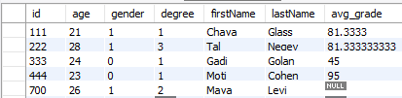
Triggers execution
INSERT INTO grades (courseId, studentId, grade, passed) VALUES (30, 222, 87, 1);
SELECT * FROM students;
DROP TRIGGER new_grade_received;

Slide 24
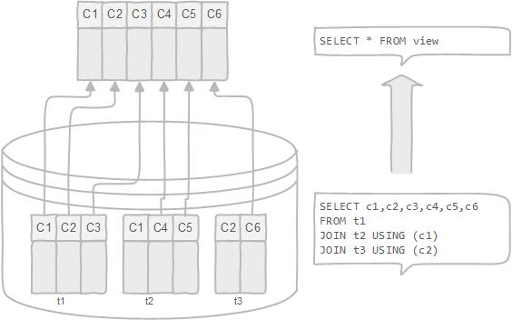
VIEWS
Simplify complex queries
Limit data access to specific users
Enable computed columns
http://www.mysqltutorial.org/introduction-sql-views.aspx

Slide 25
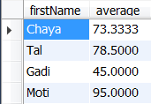
View Example
CREATE VIEW avg_grades_view AS
SELECT students.firstName, AVG(grade) AS average
FROM grades
INNER JOIN students ON grades.studentId = students.id
GROUP BY studentId;
SELECT * FROM avg_grades_view
UPDATE avg_grades_view SET average=75 WHERE firstName LIKE 'Chaya';

Slide 26
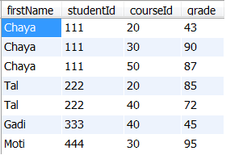
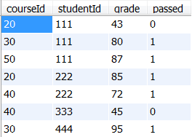
Updatable View
CREATE VIEW full_grades_view AS
SELECT students.firstName, studentId, courseId, grade FROM grades INNER JOIN students ON grades.studentId = students.id;
SELECT * FROM full_grades_view;
UPDATE full_grades_view SET grade = 80 WHERE firstName LIKE 'Chaya' AND courseId=30;
SELECT * FROM grades;

Slide 27
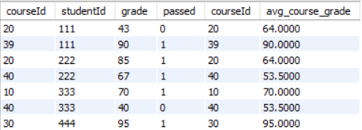
Window Functions
Window functions act on the aggregating functions, but do not reduce the number of rows (to match the number of groups).
This is very useful when we want to obtain all the original input and join it with new information.
E.g.: Suppose we want to get the grades of all the students, but also compare them to the average grade in each course.
SELECT * FROM grades JOIN (SELECT courseId, avg(grade) as avg_course_grade FROM grades GROUP BY courseId) AS with_avg ON grades.courseId = with_avg.courseId;

Slide 28
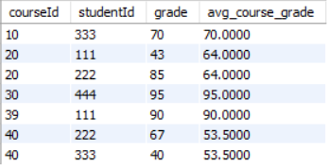
Window Functions (cont.)
SELECT courseId, studentId, grade, avg(grade) OVER (PARTITION BY courseId) AS avg_course_grade FROM grades;

Slide 29
Connecting to MySQL from Java (Connector /J)

Slide 30



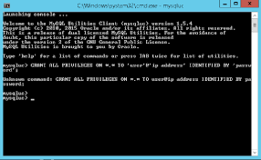



Methods to connect to MySQL Server

Slide 31
SELECT * FROM students (in JAVA)
import java.sql.*;
public class Main{
public static void main(String[] args){
try{
Class.forName("com.mysql.jdbc.Driver");
try(Connection con = DriverManager.getConnection("jdbc:mysql://localhost:3306/test", "user", "pwd")){
Statement stmt = con.createStatement();
ResultSet rs = stmt.executeQuery("SELECT * FROM students");
int numOfColumns = rs.getMetaData().getColumnCount();
while (rs.next()){
for (int col = 1; col <= numOfColumns; col++){
System.out.print(rs.getString(col) + " ");
}
System.out.println();
}
}} catch (Exception ex){ex.printStackTrace();}
}
}
Reflection
Try with resources (java 7). No need to call con.close()
111 21 1 1 Chaya Glass 73.33
222 28 1 3 Tal Negev null
333 24 0 1 Gadi Golan null
444 23 0 1 Moti Cohen null
700 26 1 2 Maya Levi null
rs is initially located before the first row
java.lang.ClassNotFoundException: com.mysql.jdbc.Driver
at java.net.URLClassLoader.findClass(URLClassLoader.java:381)
at java.lang.ClassLoader.loadClass(ClassLoader.java:424)
at sun.misc.Launcher$AppClassLoader.loadClass(Launcher.java:331)
at java.lang.ClassLoader.loadClass(ClassLoader.java:357)
at java.lang.Class.forName0(Native Method)
at java.lang.Class.forName(Class.java:264)
at ariel.databases.Main.main(Main.java:19)
To get column names we can use:
rs.getMetaData().getColumnLabel(col)
Notes:
Id, age, gender, degree, firstName, lastName, avg_grade
Reflection: odd that we don't need to actually use the class, but it has a static initializer which registers the driver.
If we don't call rs.next() at the beginning we will get an error!

Slide 32
Jar file is missing
Solution 1: use Gradel.
Solution 2:
Goto https://dev.mysql.com/downloads/connector/j/ download jar file.
Create a bin folder: copy jar file into the folder
Add bin to libraries (in IntelliJ: Project Structure -> Libraries -> + -> JAVA -> find bin directory)

Slide 33
prepareStatement
prepareStatement allows the creating of a statement with missing parameters and filling them up later.
May be faster and can provide some level of security (especially when part of the query are obtained from user input)
String query = "DELETE FROM students WHERE studentId=?"
try (PreparedStatement pstmt = con.prepareStatement(query)) { pstmt.setString(1, userId); pstmt.executeUpdate(); }

Slide 34
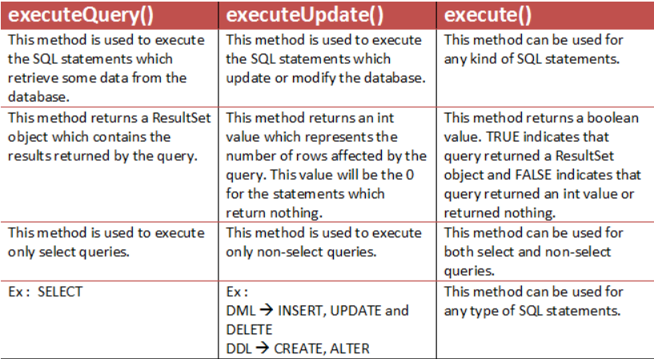
executeQuery(), executeUpdate(), execute()
Credit: http://javaconceptoftheday.com/difference-between-executequery-executeupdate-execute-in-jdbc/

Slide 35
Executing Stored Procedure
String query = "{CALL student_avg(?)}";
CallableStatement stmt = con.prepareCall(query);
int studentId = 222;
stmt.setInt(1, studentId);
ResultSet rs = stmt.executeQuery();

Slide 36
Stored Procedure Using Out Params
CallableStatement stmt = con.prepareCall("CALL student_avg_2(?,?,?)");
stmt.setInt(1, n);
stmt.registerOutParameter (2, Types.DOUBLE);
stmt.registerOutParameter(3, Types.INTEGER);
stmt.execute();
Double avgGrade = stmt.getDouble(2);
Integer maxGrade = stmt.getInt(3);
System.out.println("the average grade is: "+avgGrade+".");
System.out.println("the maximum grade is: "+maxGrade+".");
Notes:
//another 2 ways to get the out data:
//Integer maxGrade = stmt.getInt("max_grade");
//Integer maxGrade = (Integer) stmt.getObject(3, Integer.class);

